Slide 1
User Experience Design
Prof. Dr. Dirk Riehle
Friedrich-Alexander University Erlangen-Nürnberg
PROD C04
Licensed under CC BY 4.0 International
Notes:
It is Friedrich-Alexander University Erlangen-Nürnberg – FAU, in short.
Corporate identity wants us to say “Friedrich-Alexander University”.

Slide 2
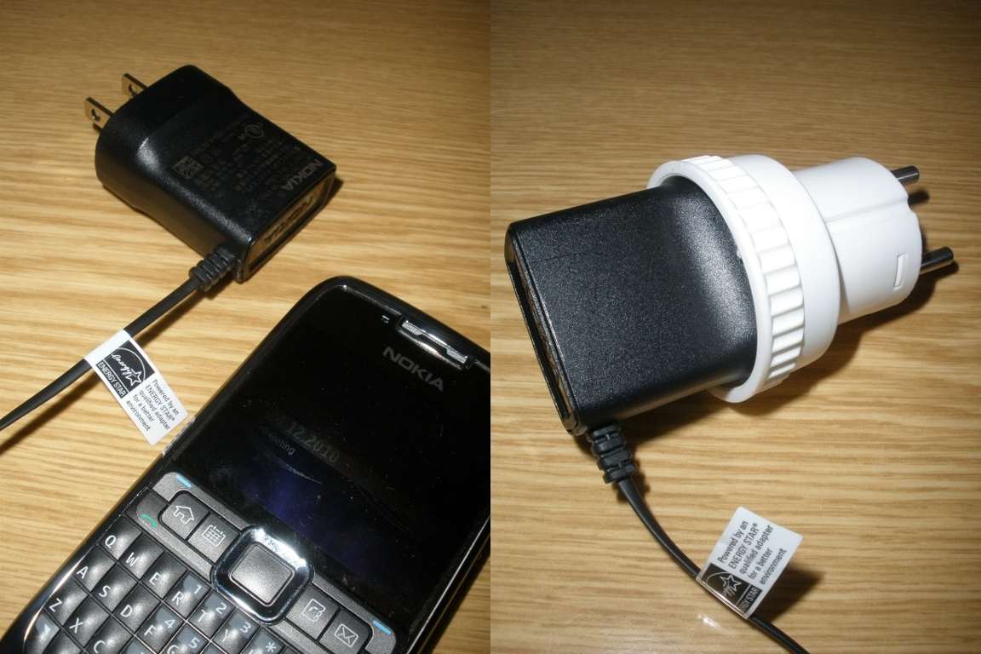

Slide 3
Photo Lesson
Fit for purpose

Slide 4
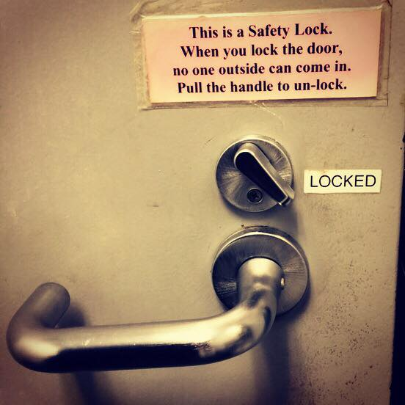

Slide 5
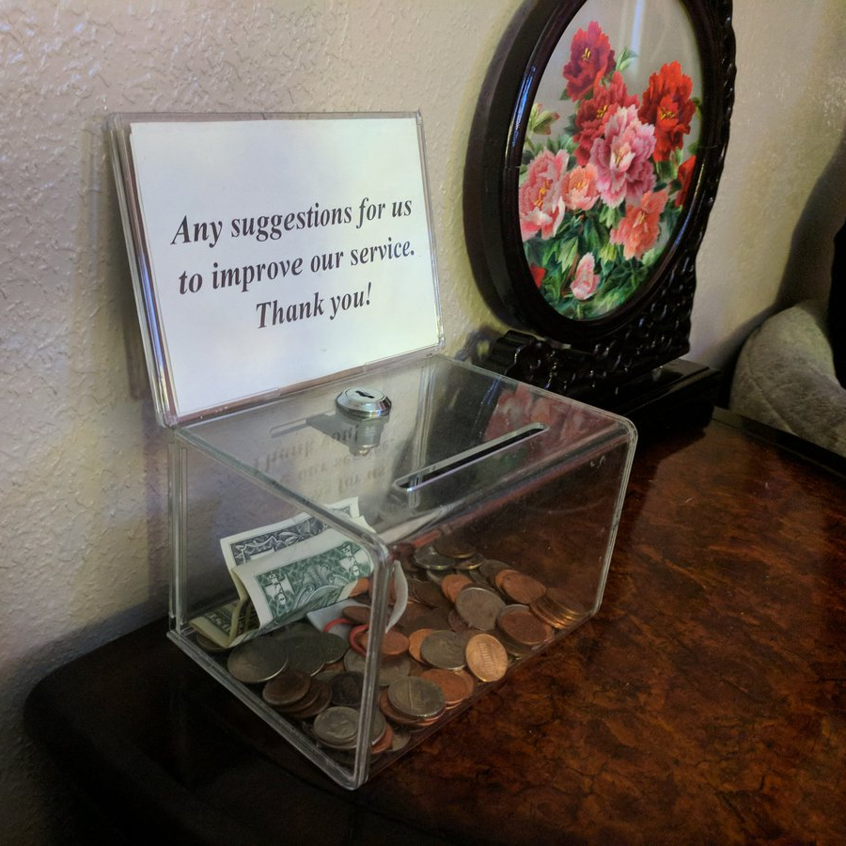
Photo (c) by Jono Bacon, used with permission

Slide 6
Photo Lesson
User expectations

Slide 7
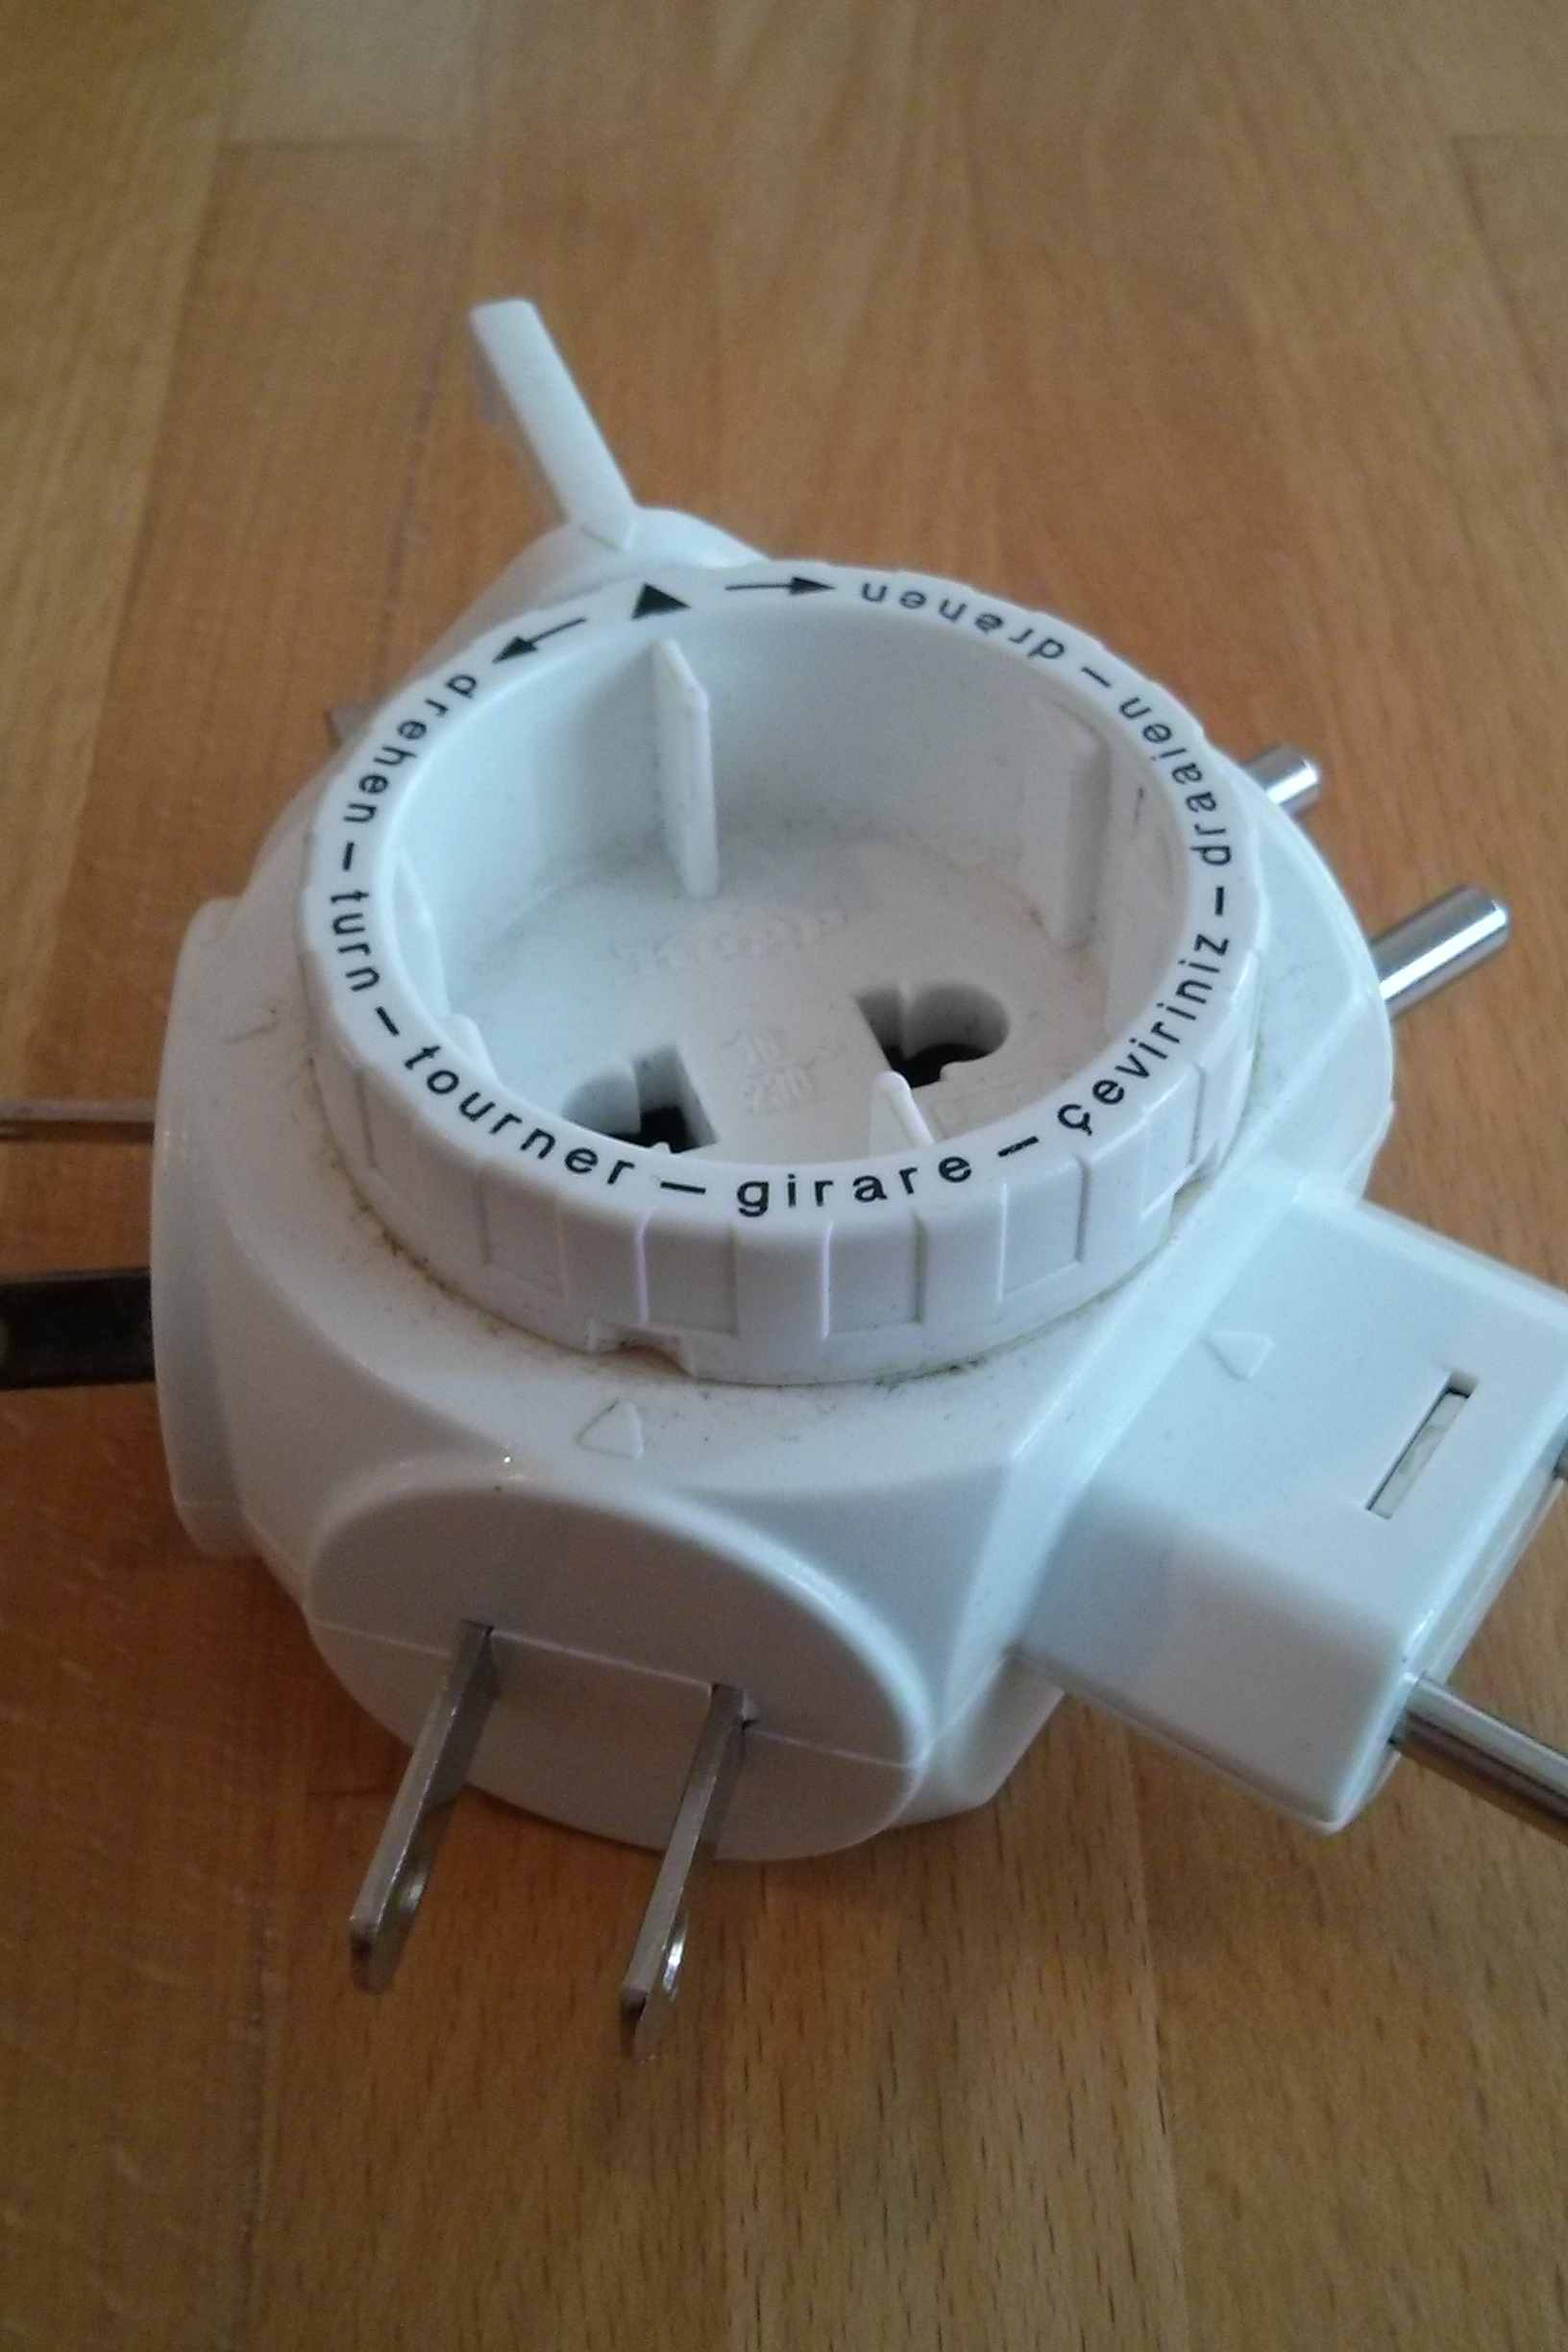
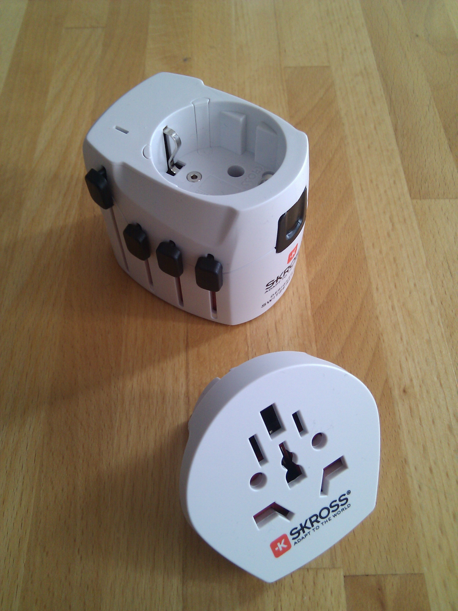

Slide 8
Photo Lesson
Incremental development

Slide 9


Slide 10
Photo Lesson
Managing stakeholders
  Maintainability

Slide 11
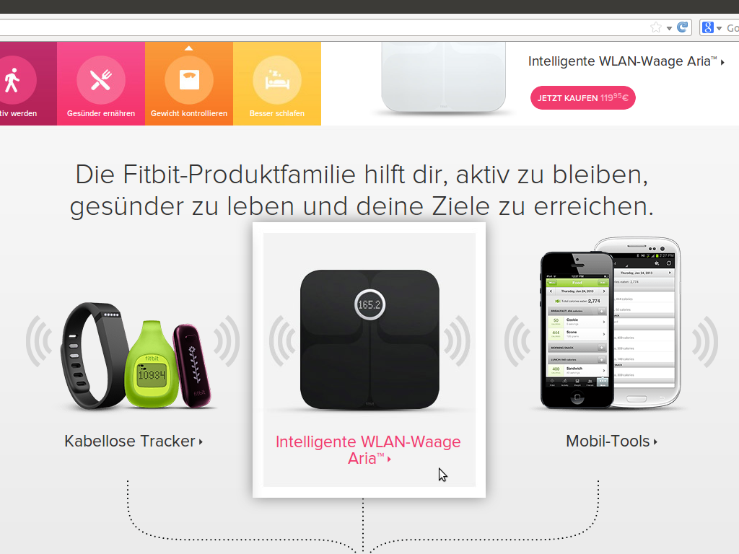

Slide 12
Photo Lesson
Non-functional requirements
  Internationalization / localization

Slide 13
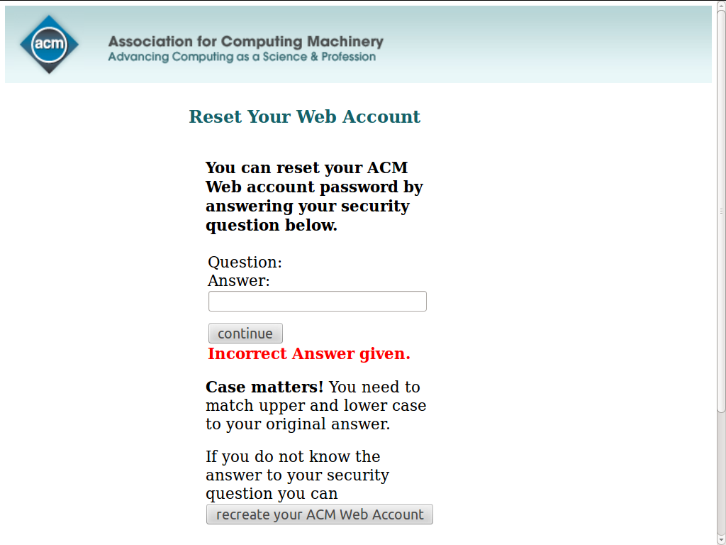

Slide 14
Photo Lesson
System evolution

Slide 15
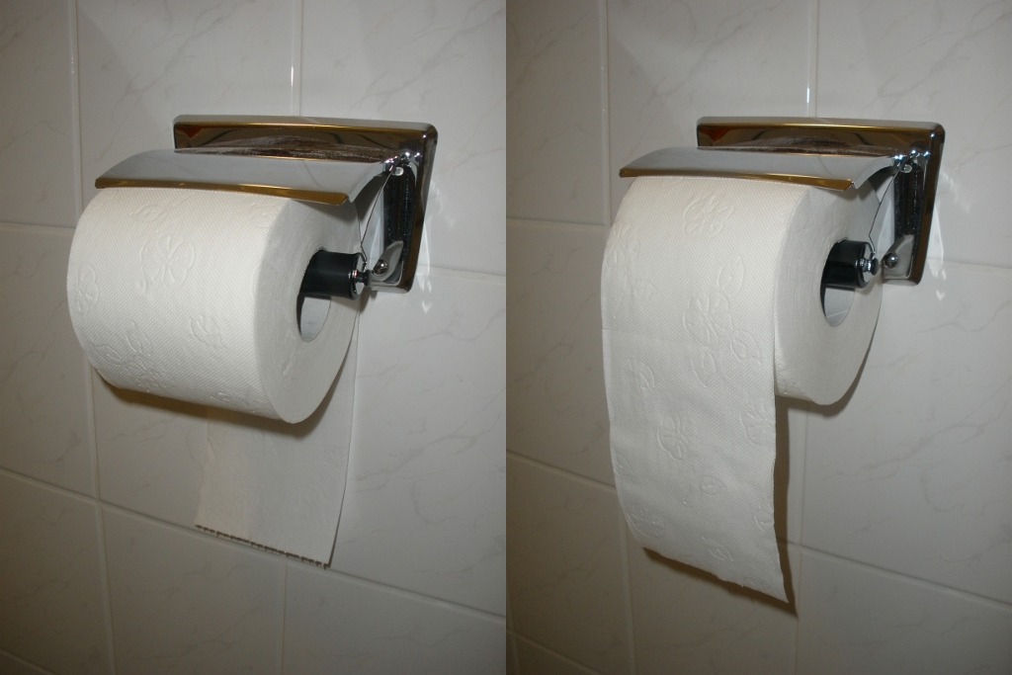

Slide 16
Photo Lesson
Unpredictable situations

Slide 17
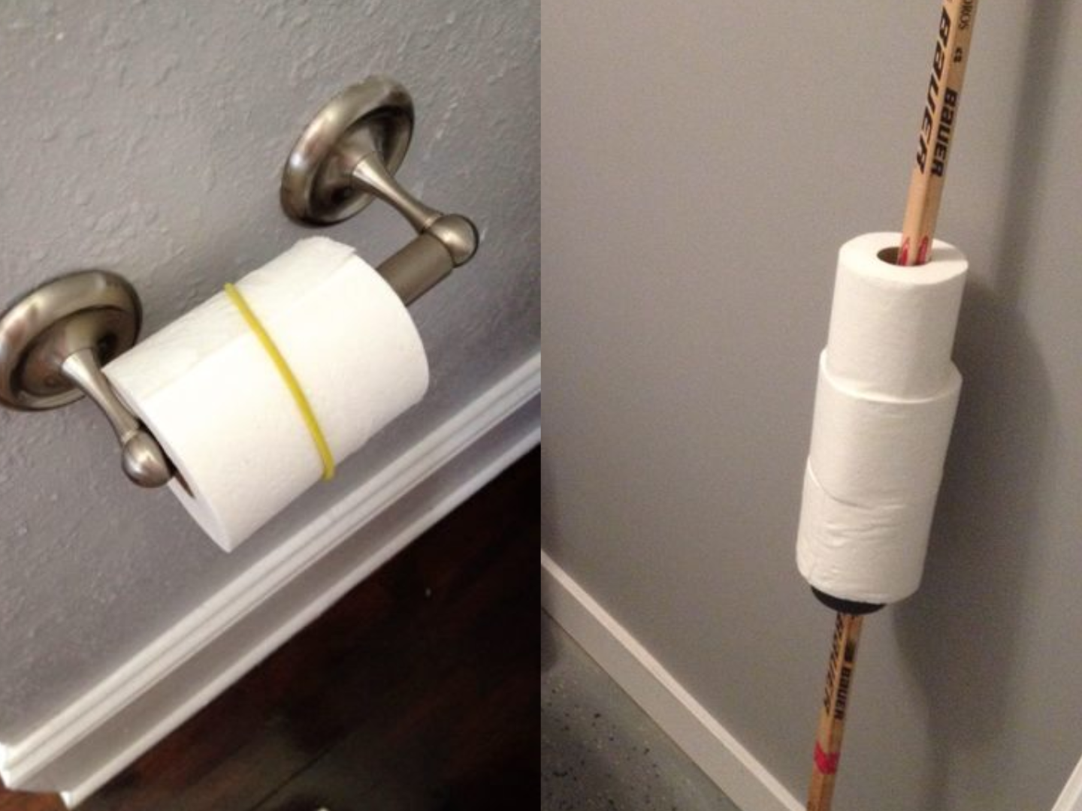

Slide 18
Review / Summary of Session
Selected dimensions of product design
  Functional requirements
  User expectations
  Incremental development
  Managing stakeholders
  Non-functional requirements
  System evolution
  Unpredictable situations

Slide 19
Thank you! Questions?
dirk.riehle@fau.de – http://osr.cs.fau.de
dirk@riehle.org – http://dirkriehle.com – @dirkriehle
DR

Slide 20
Credits and License
Original version
  © 2012-2018 Dirk Riehle, some rights reserved
  Licensed under the Creative Commons Attribution 4.0 International License
Contributions
  ...

